Slide 1
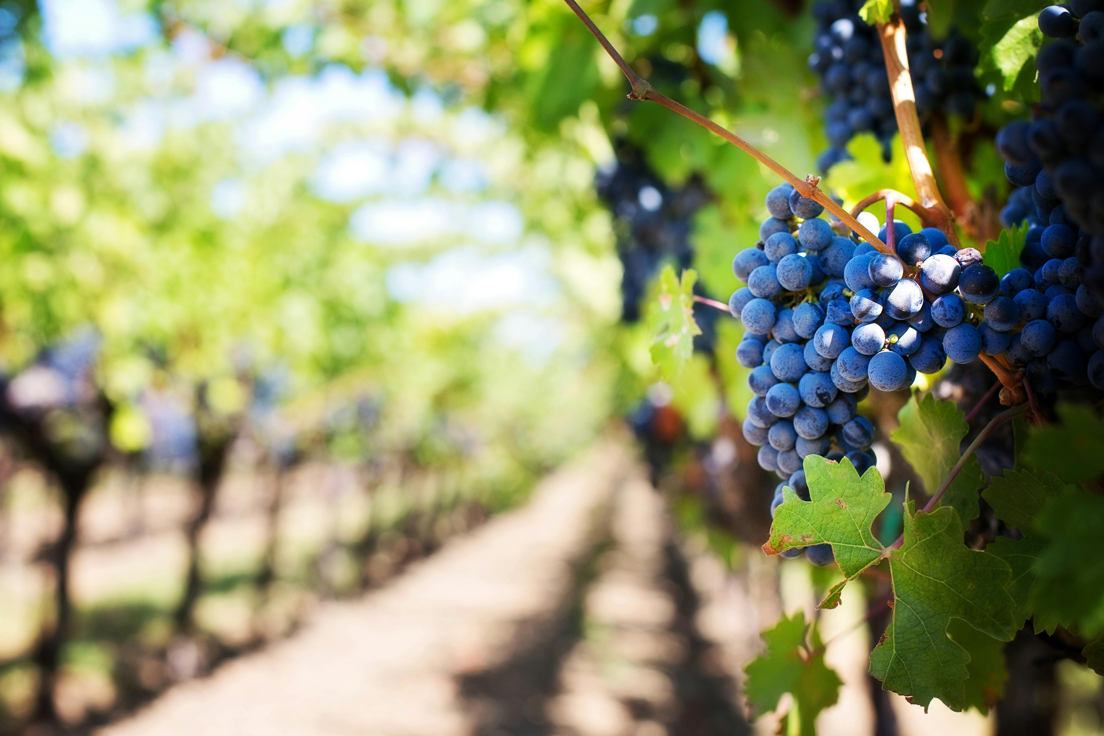
"Elevating Wine Quality with Data-Driven Insights" Robert Renzoni Vineyards Riverside California
Presented By:
Tracy Dower
Sumtana Camara
Special Thanks to Head Vintner
Olivia Bue

Slide 2

Introduction & Objectives
What makes a high-quality wine?
Our goal is to improve the consistency and quality of Olivia Bue Wines by utilizing data driven insights to provide clear recommendations based on real data.
This Photo by Unknown Author is licensed under CC BY-NC-ND
Notes:
Wine quality is a complex attribute shaped by a combination of chemical characteristics, production techniques, and environmental influences.
Robert Renzoni Vineyards sets out with two core objectives: Objective A: Predict wine quality (minimize MAE)Objective B: Identify key drivers of high-quality wine

Slide 3
What Makes a Great Wine?
Top factors that consistently lead to higher quality wines
Alcohol Level
Balanced Sulphates
Higher alcohol often means fuller flavor and better ratings
Enhance flavor and preservation
Lower Volatile Acidity
Citric Acid & pH
Influence freshness and balance
Less sour/vinegar taste
=
better experience

Slide 4
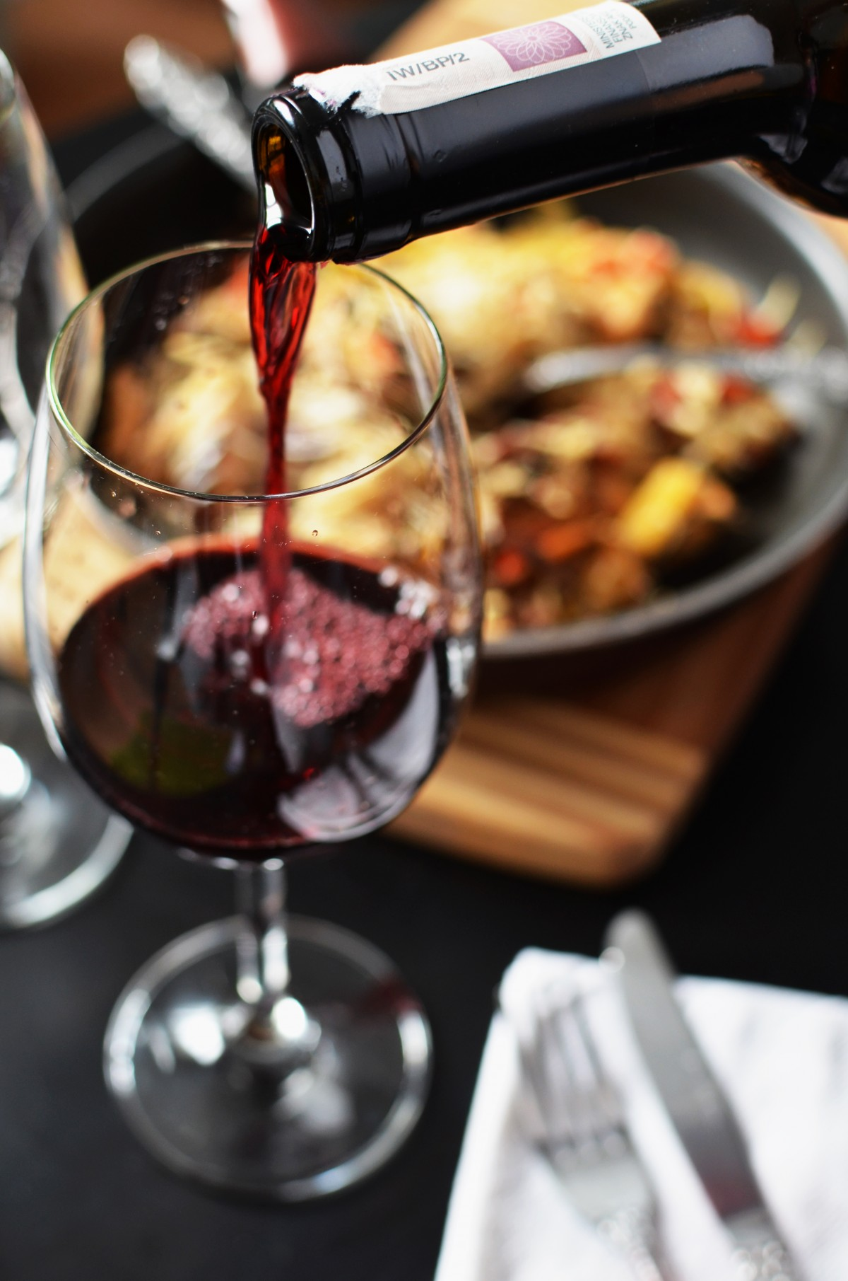
What We Looked At
Chemical measurements
Acidity
Sugar
Alcohol
Expert wine quality ratings
0 = Very Bad
10 = Very Excellent
Wine Types
Red
White
(Various Locations)
Notes:
Visual: Simplified graphic (wine bottle + lab beaker + rating star = quality)

Slide 5
Our Process
Cleaned the data
Handled missing values
Testing
Tested different approaches to predict wine quality
Identified
What really matters in making a high-quality wine and why.
Notes:
Visual: Flowchart with icons — “Data → Model → Insights → Recommendations”

Slide 6
Our Findings
Forecasting for success​
Key Metrics
Revenue by year
 | clients | orders | Gross avenue | Net revenue
20XX​ | 10​ | 1100​ | $10,000​ | $7,000​
20XX​ | 20​ | 200​ | $20,000​ | $16,000​
20XX​ | 30​ | 300​ | $30,000​ | $25,000​
20XX​ | 40​ | 400​ | $40,000​ | $30,000
Notes:
Replace with our findings from the wine data

Slide 7
Predictive Tool in Action
(Optional)
We built a tool that can predict wine quality before tasting
Helps spot potential issues early or test new blends
Visual: prediction results
$3B
$2B
$1B
Opportunity to build​
Fully inclusive market​
Total addressable market​
Freedom to invent​
Selectively inclusive market​
Serviceable available market​
​
Few competitors​
Specifically targeted market​
Serviceable obtainable market​
​
Notes:
Optional slide (if relevant to Olivia):We built a tool that can predict wine quality before tasting Helps spot potential issues early or test new blends Visual: Screenshot or mockup of prediction results

Slide 8
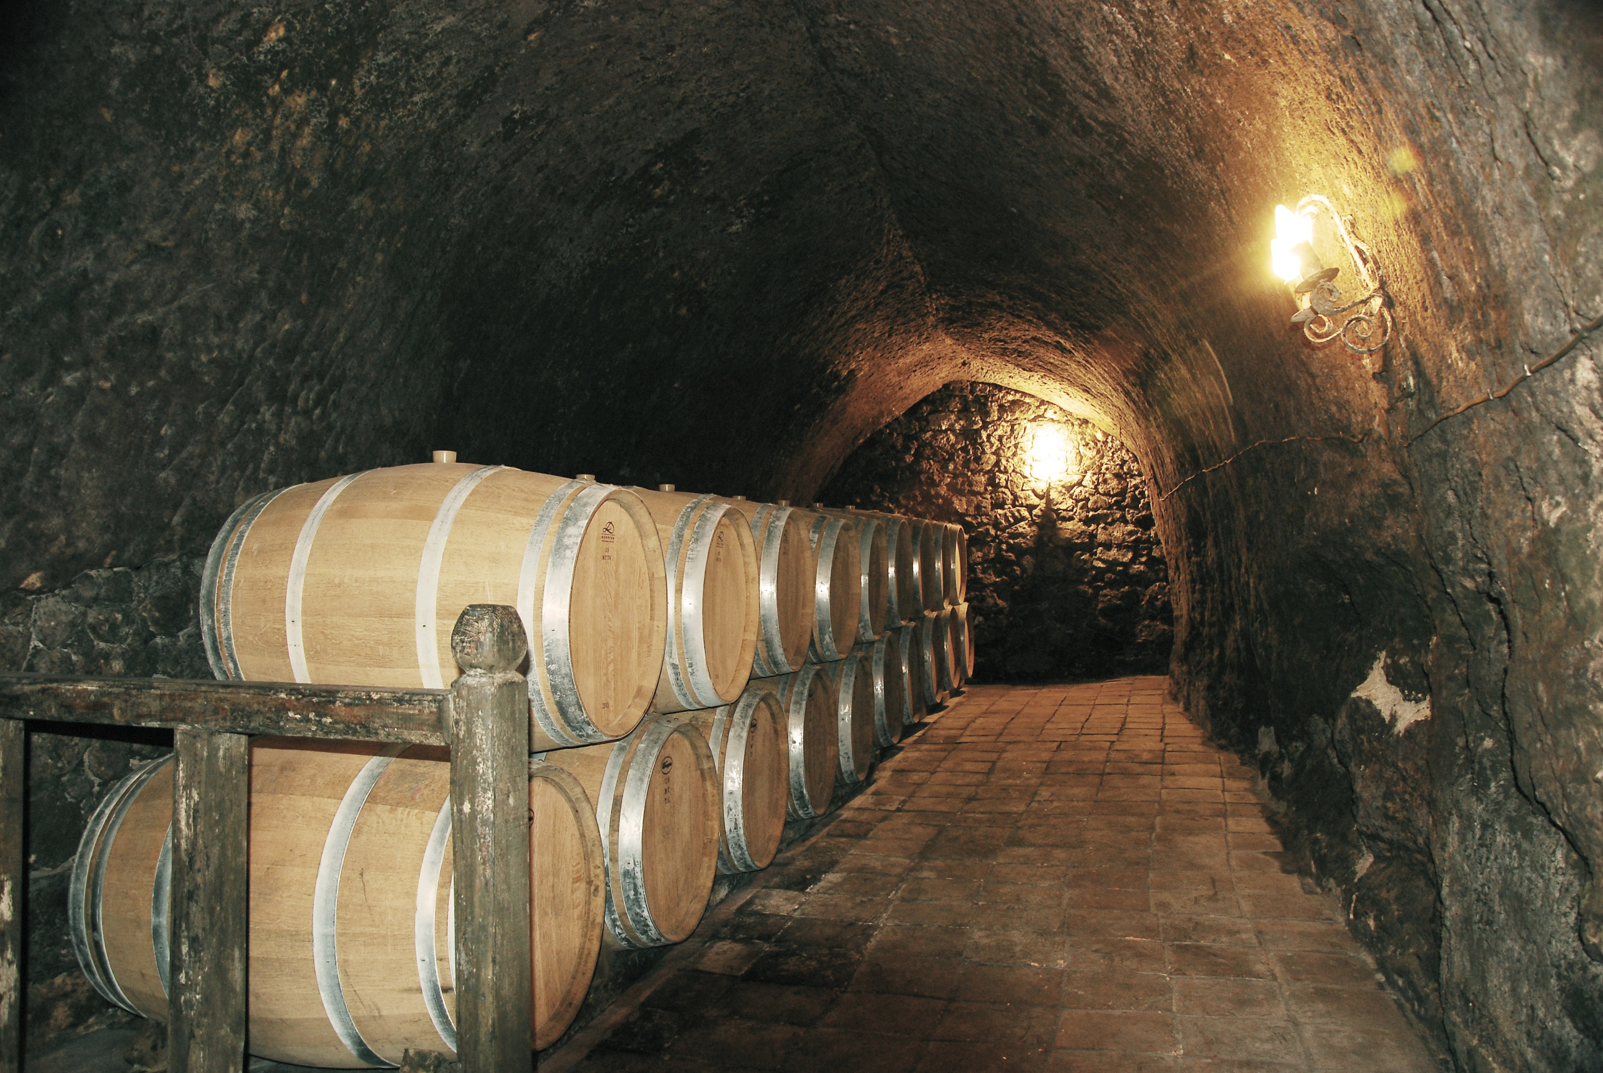
What This Means for You
Actionable Recommendations
Target specific alcohol ranges for optimal balance
Keep volatile acidity low during fermentation
Fine-tune sulphate levels to lift wine character
Use pH and citric acid as dials to adjust freshness and stability

Slide 9
What we delivered
Summary
A clearer understanding of what impacts wine quality
A set of data-driven, winemaker-friendly recommendations
Tools to support more consistent production outcomes
“We used science to uncover what your palate already knows — now you can use both.”​

Slide 10
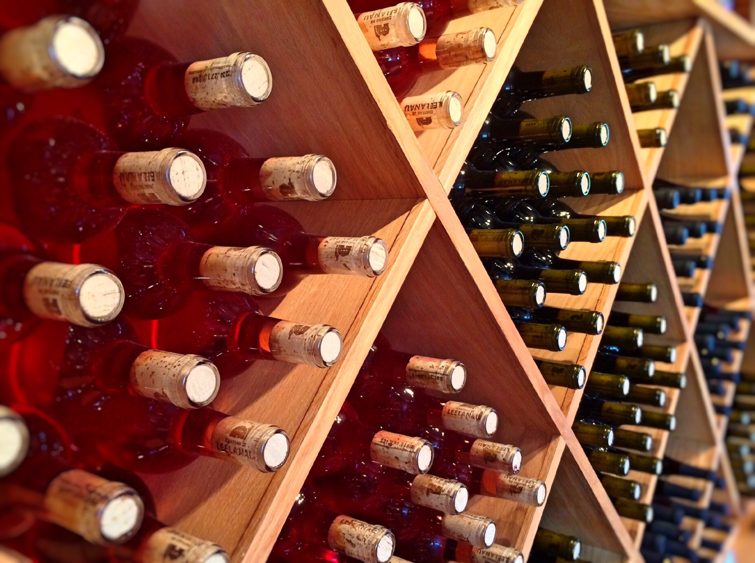
Thank you
Tracy Dower – tdower@smu.du
Sue Camara – scamara@smu.edu

